Slide 1
CSCI 1301 Introduction to Computing and Programming
Summer 2015

Slide 2
Announcements
Project 3 posted tonight.
Lab 4 due Friday, June 29th, 9PM
Readings for this week: Ch 4 (Looping). Read it twice!
Tests are graded. Come by office hours to see exams
Withdrawal Deadline: Tuesday (June 30th). If you want to discuss your grades, feel free to come by office hours.
Lab / Project Grades – Rubrics online
Remember: You have one week from the time a lab is graded to dispute your grade.
Practice debugging (from lab 4)!
Indentation and debugging will help avoid / eliminate errors!
Go over Test

Slide 3
Flow of Control: Loops
Chapter 4

Slide 4
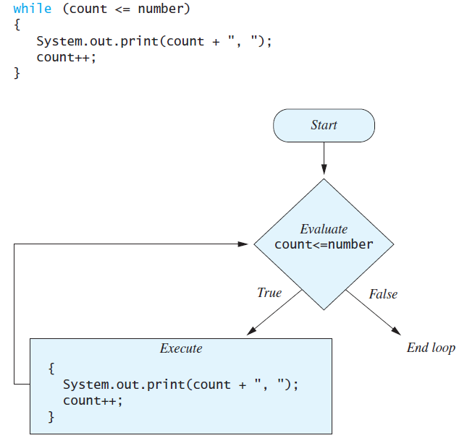
The while Statement

Slide 5
import java.util.Scanner;
public class WhileDemo
{
public static void main(String[] args)
{
int count, number;
System.out.println("Enter a number");
Scanner keyboard = new Scanner(System.in);
number = keyboard.nextInt( );
count = 1;
while (count <= number)
{
System.out.print(count + ", ");
count++;
}
System.out.println( );
System.out.println("Yay! We can count!");
}
}
What if we input 0?

Slide 6
Example
Write a loop to see if the letter x is contained in a string entered by the user using only the charAt() and length() methods.

Slide 7
Programming Example: Student Section
Given
Average size of a student football fan (Volume): 2.5 cubic feet
Why are we using volume instead of seats?
Initial fan count
Rate of increase: 95% per hour (almost double per hour)
Volume of the student section
Find
Number of hours to exceed the capacity of the student section
Number and volume of fans that filled the section
Note: Problem assumes the section has no additional obstacles and the students fill the section with no space between them (Realistic at UGA and it simplifies the problem).

Slide 8
Programming Example: Student Section
The general algorithm.
Get volume of student section.
Get initial number of fans in section.
Compute number of hours until overflow.
Display results.

Slide 9
Programming Example: Student Section
How do we compute the number of hours until overflow?
We need to compute number of hours, so lets create a variable for that (counter starts at 0).
We can compute total volume by multiplying the initial number of students with average size.
This is population at hour 0.
Are we done?
Well, not if they haven’t filled the section.
If they haven’t, what do we do?
We compute the volume of new students added in first hour and add this to the total.
Now, check again if we are done.
Continue doing this. See the loop pattern?

Slide 10
Programming Example: Student Section
Variables Needed
GROWTH_RATE —hourly growth rate of the fan population
(a constant 0.95)
ONE_STUDENT_VOLUME —volume of an average student
(a constant 2.5)
sectionVolume — volume of the student section
startPopulation —initial number of students
countHour —hour counter
Population —current number of students
totalStudentVolume —total volume of all the students
newStudents —number of students that joined this hour
newStudentVolume —volume of new students

Slide 11
import java.util.Scanner;
/**
Program to calculate how long it will take fill the student section in Sanford Stadium
*/
public class StudentSection
{
public static final double GROWTH_RATE = 0.95; //95% per hour
public static final double ONE_STUDENT_VOLUME = 2.5; //cubic feet
public static void main(String[] args)
{
System.out.println("Enter the total volume of the student section");
System.out.print("in cubic feet: ");
Scanner keyboard = new Scanner(System.in);
double sectionVolume = keyboard.nextDouble( );
System.out.println("Enter the number of");
System.out.print(“students currently in the section: ");
int startPopulation = keyboard.nextInt( );
int countHour = 0;
double population = startPopulation;
double totalStudentVolume = population * ONE_STUDENT_VOLUME;

Slide 12
while (totalStudentVolume < sectionVolume)
{
double newStudents = population * GROWTH_RATE;
double newStudentVolume = newStudents * ONE_STUDENT_VOLUME;
population = population + newStudents;
totalStudentVolume = totalStudentVolume + newStudentVolume;
countHour++;
}
System.out.println("Starting with a population of " +
startPopulation);
System.out.println("and a student section with a volume of "+sectionVolume +
" cubic feet,");
System.out.println("after " + countHour + " hours,");
System.out.println("the section will be filled with " +
(int)population + " rowdy students.");
System.out.println("They will fill a volume of " +
(int)totalStudentVolume + " cubic feet.");
System.out.println(“Better not leave your seat!");
}
}

Slide 13
Infinite Loops
A loop which repeats without end is called an infinite loop.
If the controlling boolean expression never becomes false, a loop will repeat without ending.
When would the following be an infinite loop?
while (totalStudentVolume < sectionVolume)
{
double newStudents = population * GROWTH_RATE;
double newStudentVolume = newStudents * ONE_STUDENT_VOLUME;
population = population + newStudents;
totalStudentVolume = totalStudentVolume + newStudentVolume;
countHour++;
}

Slide 14
Infinite Loops
while(true)
{
System.out.println("Create HW");
System.out.println("Assign HW");
System.out.println("Collect HW");
System.out.println("Grade HW");
System.out.println("Return HW");
}

Slide 15
Designing Loops
To design the loop body, write out the actions the code must accomplish.
Then look for a repeated pattern.
The pattern need not start with the first action. First action may occur outside of loop.
The repeated pattern will form the body of the loop.
Some actions may need to be done after the pattern stops repeating.

Slide 16
Designing Loops
Loops typically consist of three parts.
The Initialization (setup variables).
The body statements (to be repeated).
The mechanism terminating the loop.
The boolean expression and ensuring that the expression becomes false.
Most problems with loops occur at the beginning or end.
Off-by-one errors
Tests whose values never change.
Regarding entering a loop:
Ensure that all variables used in the loop are initialized properly.
(in many loops, there is a single variable used to control the loop; ensure that it has the proper initial value).
Ensure that the controlling expression will evaluate correctly at the start of the loop.

Slide 17
Practice
Input: String s, where s.length() > 0
Output: The number of English lowercase letters in s
Hint: Character.isLowerCase(<char>) tests a character to see if it is lower case.
Examples
Enter a String s: BanAnA
Output: BanAnA has 3 lowercase letters
Enter a String s: ABcdefGHi123;
Output: ABcdefGHi123; has 5 lowercase letters

Slide 18
Practice (cont.)
Assume a user inputs a String s that contains at least one character. Print the String s in reverse order. For example, if s is “abcd”, then “dcba” should be printed. The program should work for any valid input String s.
Suppose we have two Strings s and t inputted by a user, where each String contains at least one character. Write a program that prints out if s and t are equal (case sensitive). For this program DO NOT use any of the following String methods: equals, equalsIgnoreCase, compareTo, compareToIgnoreCase.

Slide 19

Calculating Fibonacci
The user will input a number. We will print the Fibonacci sequence up to that number.
The Fibonacci sequence is the sequence of numbers:
0, 1, 1, 2, 3, 5, 8, 13, 21, 34, 55, …
Each number found by adding up the two numbers before it.
How do we calculate Fib(4)?
Fib(4) = Fib(3) + Fib(2)

Slide 20
Calculating Fibonacci
How do we calculate Fib(5)?
Fib(5) = Fib(4) + Fib(3)
Well, we still need to know Fib(4) and Fib(3)
If we start out by knowing that Fib(0) = 0 and Fib(1) = 1
Then we can do the following calculations for Fib(5):
Fib(2) = Fib(0) + Fib(1)
Fib(3) = Fib(1) + Fib(2)
Fib(4) = Fib(2) + Fib(3)
Fib(5) = Fib(3) + Fib(4)
We will use two integer variables, fib1 and
fib2 (which start at 0 and 1), to keep up with the
two values needed to compute the current
Fibonacci number. This will change as
we count up.

Slide 21
import java.util.Scanner;
public class Fibonacci {
public static void main(String[] args) {
System.out.println("Enter a nonnegative number");
Scanner keyboard = new Scanner(System.in);
int n = keyboard.nextInt( );
int fibN = 0;
if(n == 0)
System.out.println(“0");
else if (n >= 1)
{
int count = 2;
int fib1 = 0;
int fib2 = 1;
System.out.print(fib1 + “ “ + fib2);
while(count <= n )
{
fibN = fib1 + fib2;
fib1 = fib2;
fib2 = fibN;
System.out.print(" "+ fibN);
count++;
}
}
else System.out.println("Number out of range!");
}}

Slide 22
Semicolon Gotcha
What if we add a semicolon after the while statement in the fibonacci program?
What if we add a semicolon after an if statement?

Slide 23
The do-while Statement
A while loop might never execute (performs 0 operations)
Why not?
Because the controlling expression is evaluated before entering the loop body.
In a do-while loop, the loop body is executed at least once.
Note the semicolon!
do
Body_Statement
while (Boolean_Expression);

Slide 24
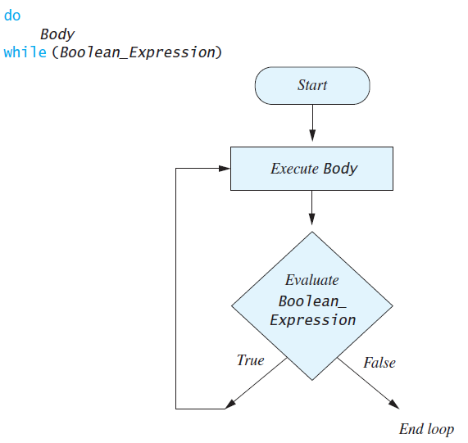
do-while vs. while

Slide 25
import java.util.*;
public class DoWhileDemo
{
public static void main(String[] args)
{
int count, number;
System.out.println("Enter a number");
Scanner keyboard = new Scanner(System.in);
number = keyboard.nextInt( );
count = 1;
do
{
System.out.print(count + ", ");
count++;
}while (count <= number);
System.out.println( );
System.out.println("Yay! More counting!");
}
}
What if we input 0?

Slide 26
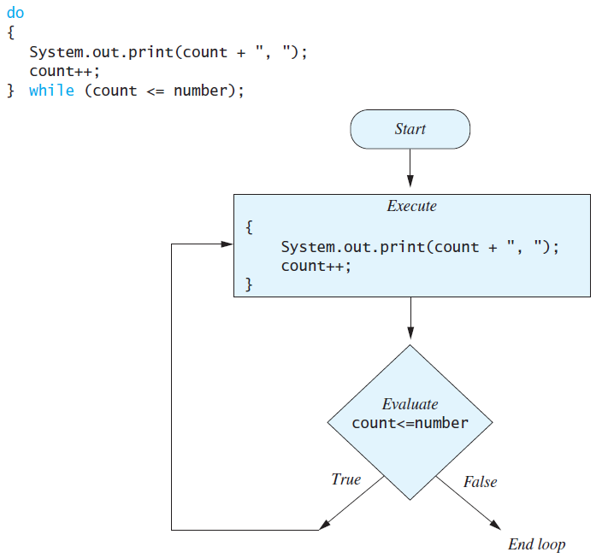
The do-while Statement

Slide 27
The do-while Statement
Steps in a do-while loop.
Execute the loop body.
Check the boolean expression.
If it is true, the loop is executed again.
If it is false, the loop is exited.
Equivalent while statement
Duplicate loop body outside of the while loop
do
Loop Body Statement(s)
while (Boolean_Condition);
Loop Body Statement(s)
while (Boolean_Condition)
Loop Body Statement(s)

Slide 28
The do-while Statement
Lets write a do-while loop that continues to check the user’s input to ensure that they enter a valid input.
For this example, we want the user to input a number between 1 and 10. If they don’t, we ask them to try again.

Slide 29
The do-while Statement
import java.util.*;
public class DoWhileDemo
{
public static void main(String[] args)
{
int number = -1;
System.out.println("Enter a number 0 - 10");
Scanner keyboard = new Scanner(System.in);
do
{
number = keyboard.nextInt( );
if (number < 0 || number > 10)
System.out.println(“Nope. Try Again ");
}while (number > 10 || number < 0);
System.out.println("Yay! You did it!");
}
}

Slide 30
Nested Loop Example – Exam Averager
Write a program to average exam scores (using while or do-while).
The program should take in exam scores until the user inputs a -1 (indicating no more scores)
Then, it divides the total of these scores by the number of scores entered to get the average.

Slide 31
import java.util.Scanner;
public class ExamAverager{
public static void main(String[] args){
System.out.println("This program computes the average of");
System.out.println("a list of (nonnegative) exam scores.");
double sum, next;
int numberOfStudents;
String answer;
Scanner keyboard = new Scanner(System.in);
…

Slide 32
System.out.println( );
System.out.println("Enter all the scores to be averaged.");
System.out.println("Enter a negative number after");
System.out.println("you have entered all the scores.");
sum = 0;
numberOfStudents = 0;
next = keyboard.nextDouble( );
while (next >= 0)
{
sum = sum + next;
numberOfStudents++;
next = keyboard.nextDouble( );
}
if (numberOfStudents > 0)
System.out.println("The average is "
+ (sum/numberOfStudents));
else
System.out.println("No scores to average.");
}
}

Slide 33
A modification to previous program to allow averaging of multiple exams
do
{
System.out.println( );
System.out.println("Enter all the scores to be averaged.");
System.out.println("Enter a negative number after");
System.out.println("you have entered all the scores.");
sum = 0;
numberOfStudents = 0;
next = keyboard.nextDouble( );
while (next >= 0)
{
sum = sum + next;
numberOfStudents++;
next = keyboard.nextDouble( );
}
if (numberOfStudents > 0)
System.out.println("The average is "
+ (sum/numberOfStudents));
else
System.out.println("No scores to average.");
System.out.println("Want to average another exam?");
System.out.println("Enter yes or no.");
answer = keyboard.next( );
}while (answer.equalsIgnoreCase("yes"));
}
}

Slide 34
More on Nested Loops
As we have seen, the body of a loop can contain any other statements, including other loops.
How can we get this output:
5 rows, 5 columns.
Each cell has value i/j
1/1 1/2 1/3 1/4 1/5
2/1 2/2 2/3 2/4 2/5
3/1 3/2 3/3 3/4 3/5
4/1 4/2 4/3 4/4 4/5
5/1 5/2 5/3 5/4 5/5

Slide 35
public static void main(String[] args) {
int row = 1;
int col = 1;
int maxRow = 6;
int maxCol = 6;
while (row < maxRow) {
while (col < maxCol) {
System.out.print(row + "/" + col + " ");
col++;
}
col = 1;
System.out.println();
row++;
}
}

Slide 36
Announcements
Project 3 is due July 14th, 9PM. Start now!
Readings for this week: Ch 4 (Looping). Read it twice!
Tests are graded. Tests can be seen during office hours
Withdrawal Deadline: June 30th. If you want to discuss your grades, feel free to come by during office hours.
Practice debugging!
Quiz 4 in class on _______________.
This week: Finish Chapter 4, section 7.1, start Chapter 5
Test Cases – make sure you test your programs!
Collaboration

Slide 37
Project 3 – Hangman 2.0
Demo
RandomWord.java ?
replacing a letter in the displayWord
reading in user input -- read as a line, look at the number of spaces. If the user enters a 10, it will never be valid. the word will be between 4 and 9 characters long

Slide 38
The for Statement
A for loop executes its body a fixed number of times (typically).
for (int count = 1; count < 3; count++)
System.out.println(count);
Syntax: for (Initialization, Condition, Update)
Body_Statement
Body_Statement can be a simple or compound statement.
The corresponding while statement is:
Initialization
while (Condition)
Body_Statement_Including_Update

Slide 39
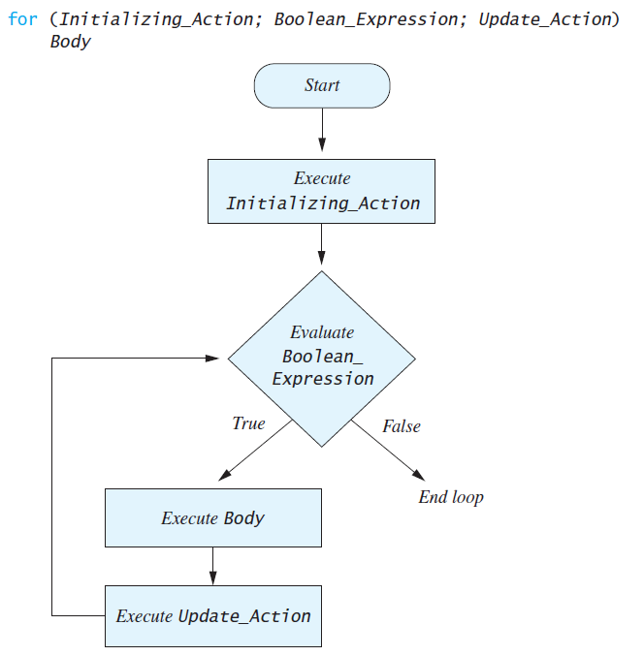

Slide 40
The for Statement
Update action can also count down. For loop:
for (int countDown = 3; countDown >= 0; countDown--){
System.out.println(countDown);
System.out.println("and counting.");
}
System.out.println(“Blast Off!”);
A While loop to do the same count down :
int countDown = 3;
while (countDown >= 0)
{
System.out.println(countDown);
System.out.println("and counting.");
countDown --;
}
Which do you prefer?

Slide 41
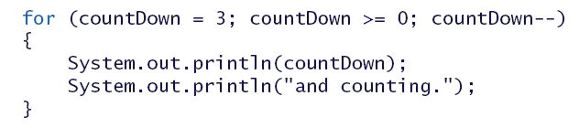
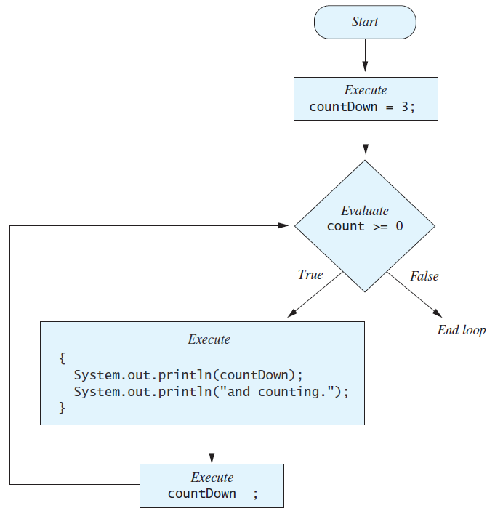

Slide 42
The for Statement
It’s possible to declare variables within a for statement.
int sum = 0;
for (int n = 1 ; n <= 10 ; n++)
sum = sum + n * n;
Variable n is “local” to the loop. It has no existence outside of the loop and can’t be accessed from outside of the loop.
Alternatively, it’s possible to use variables declared outside of the loop.
int sum = 0;
for (int n = 1 ; n <= 10 ; n++)
sum = sum + n * n;
System.out.println(n); //is this legal?

Slide 43
The for Statement
Multiple, comma separated initializations are possible.
for (n = 1, product = 1; n <= 10; n++)
product = product * n;
Only 1 Boolean expression is allowed, but it can be compound.
Multiple update actions are allowed, too.
for (n = 1, product = 1; n <= 10; product = product * n, n++);

Slide 44
The for Statement
What is the output produced by the following code? Also, what is the value of n when the loop exits?
int n;
for (n = 1; n <= 4; n++)
System.out.println(n);
for (n = 1; n <= 3; n--)
System.out.println(n);
for (n = 0; n < 10; n++)
System.out.println(n);
for (n = 1; n <= 9; n++);
System.out.println(n);

Slide 45
Tracing Variables
Code involving loops is more complex and consequently more difficult to debug than what we’ve seen earlier.
Consequently, it’s more important to monitor the values of variables as program execution progresses.
The techniques are the same as for other debugging.
insert temporary output statements in your program to print of the values of variables.
Use the debugger of your IDE (if there is one).

Slide 46
The for Statement
What is the output produced by the following code?
int j;
int i = 0;
int y = 0;
for(j = 0; j < 3; j++){
i = 0;
while(i < 4){
y++;
i++;
}
}
System.out.println(i);
System.out.println(j);
System.out.println(y);
2 other examples under “Sample Code” on eLC
LoopPractice1.java and LoopPractice2.java

Slide 47
Controlling Number of Loop Iterations
If the number of iterations is known beforehand, the loop is a count-controlled loop.
It lends itself to implementation with what type of loop?
for(int b = 99; b > 0; b--)
System.out.println(b + ” bottles ...");

Slide 48
Controlling Number of Loop Iterations
If the number of iterations is not known beforehand, one option is to prompt the user to stop the loop.
Asking the user before each iteration if it is time to end the loop is called the ask-before-iterating technique.
This is only appropriate for a small number of iterations.
Use a while loop or a do-while loop.
boolean keepGoing = true;
Scanner kb = new Scanner(System.in);
while(keepGoing)
{
System.out.println("Would you like to continue (Y/N)?");
if(kb.next().equals("Y"))
keepGoing = true;
else
keepGoing = false;
}

Slide 49
Controlling Number of Loop Iterations
Could also use a sentinel value to signal the end.
The sentinel is identifiably different from other possible inputs.
// One of these is different than the others.
90 98 80 81 23 65 10 88 -1

Slide 50
Controlling Number of Loop Iterations
int next = kb.nextInt();
while (next >= 0)
{
//Process_The_Int
next = kb.nextInt();
}

Slide 51
import java.util.Scanner;
/**
Illustrates the use of a boolean variable to end loop iteration.
*/
public class BooleanDemo
{
public static void main(String[] args)
{
System.out.println("Enter nonnegative numbers.");
System.out.println("Place a negative number at the end");
System.out.println("to serve as an end marker.");
int sum = 0;
boolean areMore = true;
Scanner keyboard = new Scanner(System.in);
while (areMore)
{
int next = keyboard.nextInt( );
if (next < 0)
areMore = false;
else
sum = sum + next;
}
System.out.println("The sum of the numbers is " + sum);
}
}

Slide 52
Aside: What if we don’t have a sentinel?
How can we read in a list of numbers, all on a single line?
Enter a list of numbers, separated by spaces
>> 84 92 88 80 72 81

Slide 53
Aside:
How can we read in a list of numbers, all on a single line?
import java.util.Scanner;
public class NumberLine {
public static void main(String[] args) {
System.out.println("Enter a list of numbers, separated by spaces");
Scanner scan = new Scanner(System.in);
String input = scan.nextLine();
scan = new Scanner(input);
while(scan.hasNextInt())
{
System.out.println(scan.nextInt());
}
System.out.println("and we're done");
}
}

Slide 54
The break Statement in Loops
A break statement can be used to end a loop immediately.
The break statement ends only the innermost loop or switch statement that contains the break statement.

Slide 55
The break Statement in Loops
What does this do?
The same as this (note the termination condition is now in the body of the loop in the above example). .
int n = 0;
while(true)
{
if(n > 10) break ;
System.out.print(n + ", ");
n++;
}
int n = 0;
while(n <= 10)
{
System.out.print(n + ", ");
n++;
}

Slide 56
The break Statement in Loops
What does this do?
for(int n = 1; n <= 5; n++)
{
if(n == 3)
break ;
System.out.println(”Hello");
}

Slide 57
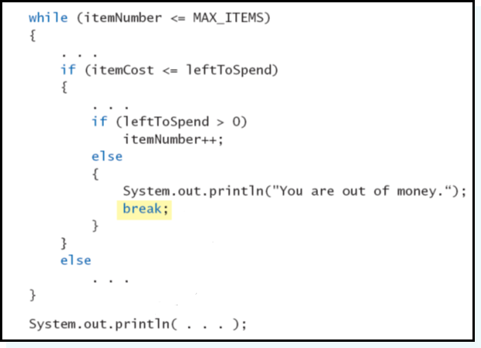
The break Statement in Loops
Use of break can be confusing.
Where does the program break to?

Slide 58
The break Statement in Loops
Use of break can be confusing.
Where does the program break to?

Slide 59
The continue Statement in Loops
A continue statement in a loop
ends current loop iteration.
Execution picks up at the next iteration.
Like break, continue only affects the innermost loop statement in which it resides.
int n = 0;
while(n < 20)
{
if(n % 2 == 0)
continue;
System.out.print(n + ", ");
n++;
}

Slide 60
Ch. 4 Practice
Working with a neighbor, write code to solve the following problems:
Assume a user inputs two nonnegative integers x and y. Without using a * operator, compute their product and print it. Do not use any methods in the Math class.
Assume a user inputs two nonnegative integers x and y. Compute x^{y}, x raised to the power of y, and print it. Do not use any methods in the Math class.

Slide 61
Exercise
Enter five integers from the keyboard.
Tally how many of them are even, how many of them are odd.
Use repetition statement.

Slide 62
Exercise II
Enter five integers from the keyboard
Tally how many of them are positive, how many of them are negative, and how many of them are zeros.
Use repetition statement.

